Slide 1

First of all thank you for giving me this opportunity to introduce my self.

Slide 2
Introduce
to
My Self

Slide 3
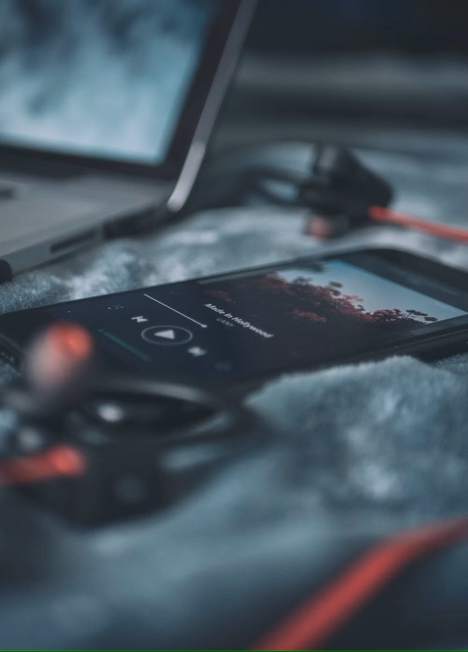


My Hobby
Listing Music
Travelling To Natural Places
Reading

Slide 4


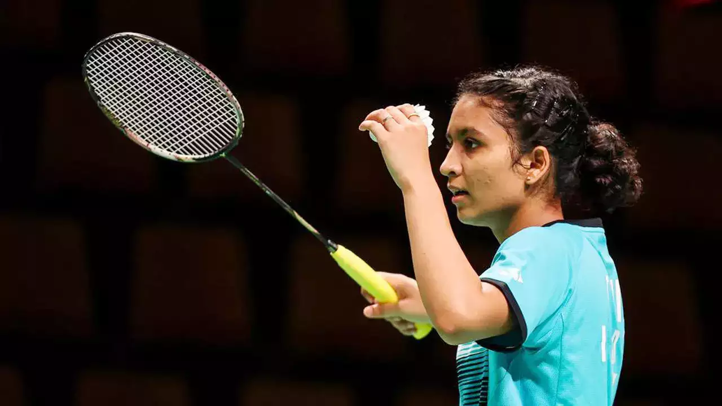
Learning New Languages
Writing
Sports

Slide 5



I Loveee ….
My Self…
My Family…
Friend’s…

Slide 6

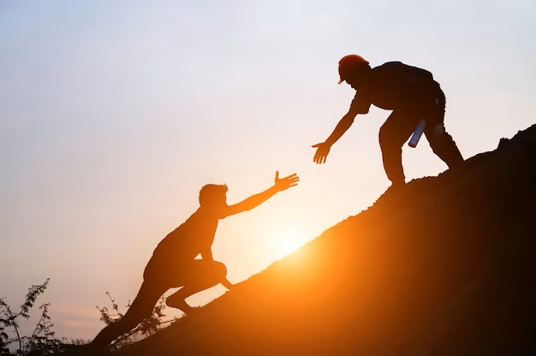
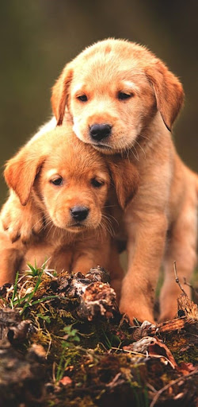
Smile…
I Can Help Other…
I Love Animal But My Fav. Dog…

Slide 7
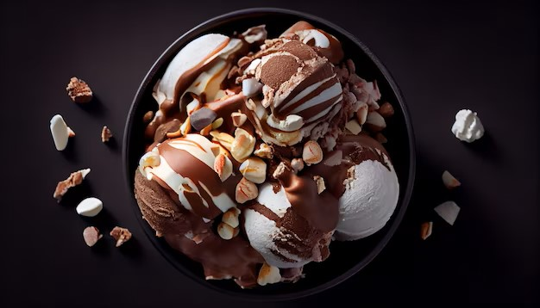
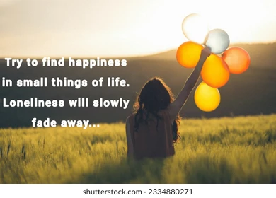
Ice cream and Chocolates
I Find Happiness in Small Things

Slide 8

I Hatee…
Anger…
Fighting…
Comparisons …
Old Thinks…

Slide 9

Opportunity
Good Position At Work.
Supportive My Family.
Mentally Prepare My Self.

Slide 10
I believe Learn from yesterday,live for today,hope your tomorrow…
Thank You

